Slide 1

Job Platform Website
Group Members:
Vaghela Purvarajsinh Kuldeepsinh (Roll No: 54)
Vaghela Mandipsinh Anirudhdhsinh (Roll No: 53)
Miroliya Rajdipsinh Natvarsinh (Roll No: 29)
Class: IMCA Semester 5, Division D

Slide 2
Project Definition
The Online Job Board Management System is a dynamic and secure web-based platform developed using the ASP.NET with Mvc Framework.
It connects Job Seekers and Employers efficiently, while an Admin oversees and manages the system.
Smart features like category-wise job notifications, pre-apply quizzes, and status tracking ensure a smoother recruitment process.

Slide 3
Problem Identification – Ineligible Applications
Many users apply for jobs even when they are not eligible as per the job requirements.
30%
ineligible candidates
70%
Eligible Applications
120 total applications

Slide 4

Our Smart Solution – Quiz-Based Eligibility Check
How It Works:
Jobseeker clicks Apply → Candidate must pass a short quiz (based on job skills).
Only if the quiz is passed, the Apply button gets activated.
If failed → Application is not submitted and feedback is shown.

Slide 5
User and Role Description
Jobseeker
Employer
Admin
Register, Login, Edit Profile
Search & Filter Jobs
Save Jobs
Take Quiz Before Applying
Track Application Status (Pending / Approved / Rejected)
Get Category-wise Job Notifications
Login & Manage Profile
Post/Edit/Delete Jobs
View and Filter Applications
Approve / Reject Candidates
Download Resumes
View & Manage All Users and Jobs
View Dashboard with Charts:
Total Jobs, Applications
Pending/Approved/Rejected Stats
Monitor System Activities

Slide 6
Project Modules
Core Modules :
User Management & Authentication
Job Posting & Search System
Quiz Eligibility Check Before Apply
Application Flow with Status Update
Saved Jobs Feature
Notifications Based on Interest Categories
Admin Dashboard with Charts
Resume Upload/Download
Profile Editing and User Control
Role-based Authorization

Slide 7
Technology Stack
Frontend
Backend
Database
Tools
ASP.NET Web Forms (Razor View)
HTML, CSS , js , Bootstrap
ASP.NET with MVC Framework
C#
Microsoft SQL Server
Visual Studio, SQL Server Management Studio (SSMS)

Slide 8
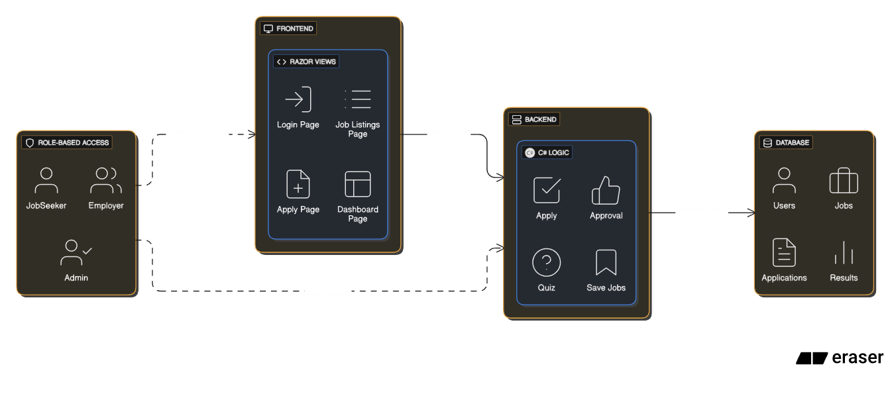


Architecture Diagram
restrict UI by role
user actions
read/write data
enforce permissions

Slide 9
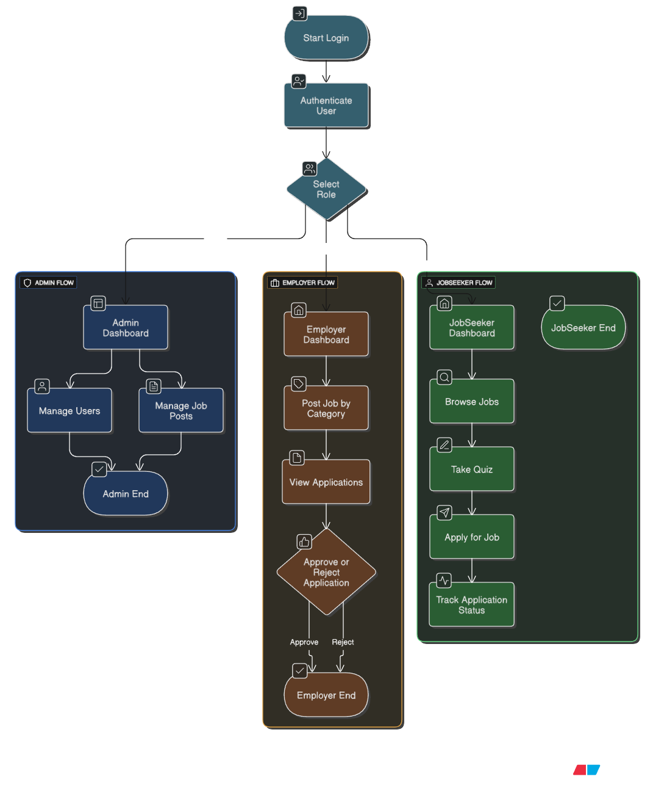

Technical Flow
Admin
Employers
Jobseeker

Slide 10
Real-Life Scope
Practical Applications :
Campus Recruitment Platforms
Internship Portals with Pre-Screening
Startup Hiring Portals
Career Guidance Platforms
Smart Features like :
Prevent ineligible applications via quiz
Interest-based job alerts
Transparent status tracking

Slide 11
Future Scope
Resume Analysis using AI
Candidate Recommendation System
Email/SMS Notification Integration
Interview Scheduling with Calendar
Admin-level job category analytics
Mobile App version

Slide 12
Conclusion
The Job Board System is practical, scalable, and solves real-world hiring problems.
It brings together job seekers, employers, and an admin into one platform using intelligent features that save time and improve accuracy.

Slide 13
Thank You

